Slide 1

Speak Fluently & Confidently B1- Course 2

Slide 2
Session 8- Complaining & Criticizing
Part 1-: Complaining & Criticizing (Listening)
Part 2: What would you say in the following
situations? ( Idioms & collocations)
Part 3: Speaking Practice
https://befluent.me/

Slide 3
Session 5- Complaining & Criticizing
Part 1-: Complaining & Criticizing
( Listening )
https://befluent.me/

Slide 4
Lesson 8 – Complaining & Criticizing
When we want to make a complaint or criticism in English, we often use specific words or phrases to make it politer and less direct. This helps the other person to listen and understand the complaint/criticism without getting defensive.
Erin had a bad experience at her bank, and now she’s complaining to a manager.
Listen to two very different ways to make complaints:
Conversation #1a - Complaining Rudely
Erin: This bank sucks!
Manager: I'm sorry you feel that way. Could you be a little more specific about the problem?
Erin: I'm sick and tired of waiting days for the problems with my account to be fixed. It's ridiculous.
Manager: I do apologize for the inconvenience. Please keep in mind that sometimes it's necessary to -
Erin: And your customer service by phone stinks, too. I will not put up with having to wait more than 20 minutes only to talk with an incompetent employee who can't do anything to help me.
Manager: I'm sorry you've had a bad experience. I will look into these issues immediately.
Erin: Oh and one more thing - the fees you charge are completely unfair. I have to pay a $5 fee every time I take money out of another bank's ATM? That's outrageous!
Manager: Ma'am, please calm down. There's no need to raise your voice.
Conversation #1b - Complaining Politely
Erin: I'd like to make a complaint. I'm very disappointed with the customer service I've received at this bank.

Slide 5
Manager: Oh no, I'm sorry to hear that. Could you tell me what happened?
Erin: Every time I have a problem with my account, it takes several days to resolve it - and that's unacceptable, because I do need access to my money on a daily basis.
Manager: I apologize for the delays, ma'am. I promise you that we will take steps to improve in this area.
Erin: Also, I'm sorry to say this, but your customer service by phone leaves a lot to be desired. Not only do I have to wait a long time to talk to someone, but the representatives are generally not very helpful.
Manager: I can understand why you're frustrated – I will look into it.
Erin: I'm also not happy about the fees that are charged for using another bank's ATM. I was expecting something like $1, but it's actually $5, and I find that rather high.
Manager: I'm afraid there's not much we can do about the fees - they're an industry standard. But I assure you that I will do everything in my power to fix the other problems you've mentioned.
Conversation Vocabulary & Phrases
Notice the difference between the first conversation and the second conversation? In the first one, Erin used strong words like “outrageous” and “ridiculous,” as well as very negative expressions like "stinks," "sucks," "incompetent" and "I'm sick and tired..."
In the second one, Erin expressed her complaints in a more diplomatic way. Here are some good phrases for complaining in English. They often include the words "sorry," "excuse me," or "I'm afraid" to make them more polite:
“I'm sorry, but I have a few complaints about…”
I’m sorry, but I have a few complaints about the cleanliness of this fitness center.
“I'm sorry to say that…” / “I hate to say this, but…”
I’m sorry to say that the food at this restaurant is not very good.
“I'm sorry to bother you, but…”
I’m sorry to bother you, but could you turn down the music?

Slide 6
“Excuse me, there is a problem with…”
Excuse me, there is a problem with my bill. I was charged an extra $50.
“There seems to be a problem with…”
There seems to be a problem with my password. I can’t log in.
“I was expecting ________, but…”
I was expecting this hair dryer to last for several years, but it broke after a week.
“I'm afraid this is unacceptable.”
“I’m not satisfied with…”
I’m not satisfied with this hotel room – it is not what was advertised on your website.
“I'm rather upset about…”
I’m rather upset about my subscription being canceled without warning.
“I'm very disappointed with…”
I’m very disappointed with the lack of organization in this program.
The manager of the bank uses a variety of phrases to respond to Erin's complaints. If you work in customer service - or if you hear some complaints from a boss or coworker - you can reply with these phrases:
“I'm sorry to hear that.”
“I'm so sorry; this will never happen again.”
“I can assure you that we’ll do everything we can to resolve the problem.”
“I apologize for the delay/inconvenience/bad experience.”
Conversation #2 – Criticism
When you need to criticize someone – say something negative about their work or behavior – it can be difficult to know what to say. Try to avoid direct statements like these:
"You're so lazy!"
"You never arrive on time."
"You talk too much."
"This design is terrible."

Slide 7
Instead, one good technique is to use the "sandwich technique" – say one good thing, then give the criticism in a polite way, then finish by saying another good thing.
Start with a positive comment, like these:
"Thanks for..."
"I appreciate..."
"I can see that you put a lot of effort into this."
Then give your criticism:
"Unfortunately..."
"The problem is that..."
"It's a bit / It's rather... (negative adjective)"
It’s a bit dirty. / It’s rather disorganized.
"I'm afraid..."
You can also include a suggestion or reason for the criticism:
"Next time, you might want to..."
"It's really necessary/important to..."
…and then finish with another positive phrase.
Let’s take a look at some mini-conversations to see this technique in action:
Mini-Conversation #2a
Nancy: Sam, what did you think of the new website I designed for our organization?
Sam: Well, I can see that you put a lot of effort into it! I appreciate the fact that it’s simple and easy to navigate. The only problem is that we really need a site that’s a little more complex, with some advanced features like scheduling appointments and receiving donations.
Nancy: Oh… I’m not sure I know how to do that.

Slide 8
Sam: That’s OK – we can use some of your great ideas to give guidelines to a professional designer.
Mini-Conversation #2b
Beth: Hi Andy – could I talk to you for a minute?
Andy: Sure.
Beth: Thanks for writing the article for our company newsletter – I appreciate all the work you did; it was very well-researched.
Andy: I’m glad you liked it!
Beth: The content was great – but unfortunately, I found a few grammatical errors in the text. It’s really important to revise these articles carefully before they’re published; otherwise, it makes the newsletter look a bit unprofessional.
Andy: Ah… I’m sorry about that. I’ll be more careful in the future.
Beth: Next time, feel free to send it to me and I’m happy to check it over. You really are a good writer, so I’d love to help you out!
Notice how each conversation begins with a compliment, then gives the criticism, then ends on a positive note.
You’ve finished Lesson 39! Now take the quiz to help you remember the polite
phrases for complaining and criticizing.

Slide 9
Quiz – Lesson 8
There to be a problem with my credit card.
looks
seems
sounds
Thanks for designing the poster. It's a good start, but it's a plain. Could you add some more color?
bit
lot
slight
Next time, you want to check with your colleagues before rescheduling an important meeting - it'll help avoid misunderstandings.
could
maybe
might
I'm very with the treatment I've received.
desperate
disappointed
disturbed
I'm sorry to that the shipment was delivered several weeks late.
say
speak
tell
I'm afraid this is .
unacceptable
unbearable

Slide 10
C. undesirable
I was to be informed of any changes, but I haven't received any information.
expecting
requiring
wishing
I can see that you put a lot of into this.
effort
power
attempt
I can you that we will look into this matter immediately.
apologize
assure
confirm
I appreciate all the work you put into preparing this proposal, but I'm it's not what we're looking for at this time.
afraid
scared
sorry

Slide 11
Lesson 8 Quiz – Answers
1.B 2.A 3.C 4.B 5.A 6.A 7.A 8.A 9.B 10.A

Slide 12
Session 8- Complaining & Criticizing
Part 2: What would you say in the following
situations? ( Idioms & collocations)
https://befluent.me/

Slide 13
Session 8- Complaining & Criticizing
I’m sorry to say this, but the soup is cold, I really can’t eat it. Could you take it to the kitchen, perhaps reheat it?
I’d like to make a complaint about this article of clothing that I bought in your store last week.
I’d like to make a complaint about the clothes that I bought here last week, here’s my receipt.
Excuse me, but I’d like to make a complaint. I’m really not happy with this delay.
Excuse me, but I’m really not happy with your response. I bought this yesterday.
Excuse me, but there’s a problem with the elevator. I’ve been waiting here for 10 minutes.
If we’re not sure about something or we want to be a little less forceful, then we can soften our language a little bit by saying
There appears…
So when we say there appears we’re not saying that actually is.
There appears to be something wrong with…
You want to tone down your complaint. So there appears to be something wrong with this is just a gentle way of asking or making a complaint.
Now, if we want to be really firm about something, we can add words like
very
really
They add emphasis to everything. Once you just add those words, they emphasise whatever you’re saying.
If you’re making a complaint, you can add them also, for example,
I was really upset when I took this garment home, I was going to wear it last night. When I took it out of the bag, there was a big mark on it, and I couldn’t wear it.
I was really upset, I was very upset.
So it’s not just upset, it’s very upset. It’s not just upset, it’s really upset.
Just use those words, to add a bit of emphasis if you want to make your complaint a little bit stronger, and a little bit more firm.
https://befluent.me/

Slide 14
Session 8- Complaining & Criticizing
Okay, so other ways you can say
This is just not acceptable. I expect more from a hotel with your reputation. It is just not acceptable.
So it’s really, really quite strong language. You’ve stressed it by saying this is really not acceptable or it’s unacceptable. It depends on which way you want to say it.
Or, again, if you want to be very, very firm.
It’s a disgrace.
If you want to add more,
It’s an absolute disgrace. I’ve waited for a week to get my car back. When I get it back, I drive it no more than half a kilometerand it breaks down.
So you’re really really annoyed and the person, mechanic, is probably aware looking at your face, and by the sound of your voice that something radically is wrong. Okay?
https://befluent.me/

Slide 15
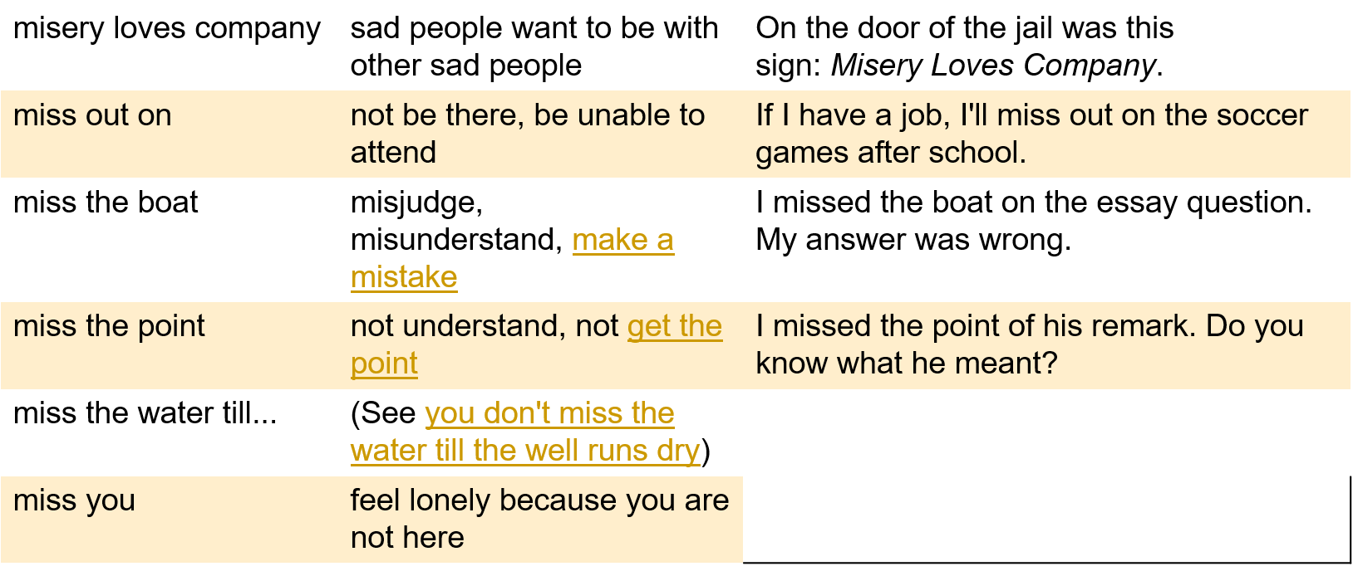
Session 8- Complaining & Criticizing
https://befluent.me/

Slide 16
Session 8- Complaining & Criticizing
Part 3: Speaking Practice
https://befluent.me/

Slide 17
Session 8- Complaining & Criticizing
1- Is it old fashioned to think a lot about the rules of etiquette?
2) What rules of etiquette would you like to change?
What customs or social rules does our country have that a foreigner might not know?
3) White Lies: Is it okay to lie in order to avoid hurting someone’s feelings?
What examples of good manners do you often see?
What examples of bad manners do you often see?
What are some examples of bad manners on the bus?
What are some examples of good manners on the subway?
What are some examples of bad manners that you HATE?
https://befluent.me/

Slide 18
Session 8- Complaining & Criticizing
Do you think people are more polite or less polite now than in the past?
Can you think of some examples of how manners have changed in our country?
How are manners different in other countries?
How important is it to be polite to older people even though they are often rude?
Your aunt wants to add you as a ‘friend’ on Facebook. You don’t really want family invading your online social life. But, you know she’d be upset if you refused her request. What would you do in this case?
How do manners differ from country to country?
Are manners essential in business?
https://befluent.me/

Slide 19
Session 8- Complaining & Criticizing
Thank you!☺
https://befluent.me/

